Slide 1
Brightness Control With Hand Detection
RA1911003010603-Dinesh babu
RA1911003010612-Pushyanth
RA1911003010621-Koteswararao

Slide 2
Problem Statement:
With the development of ubiquitous computing, current user interaction approaches with keyboard, mouse and pen are not sufficient. Due to the limitation of these devices the useable command set is also limited. Direct use of hands can be used as an input device for providing natural interaction.

Slide 3
Aim:
To process the image and apply brightness based on the distance between thumb and index fingertip.
To control the Brightness of the computer using Hand Gestures without using buttons.

Slide 4
Algorithm:
Import all required libraries
Initializing Hands model
Process the image and apply brightness based on the distance between thumb and index fingertip

Slide 5
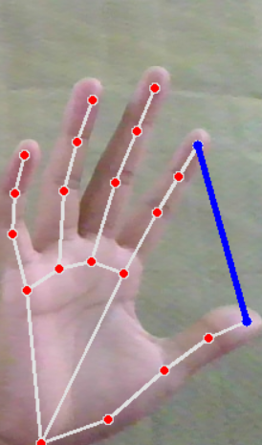
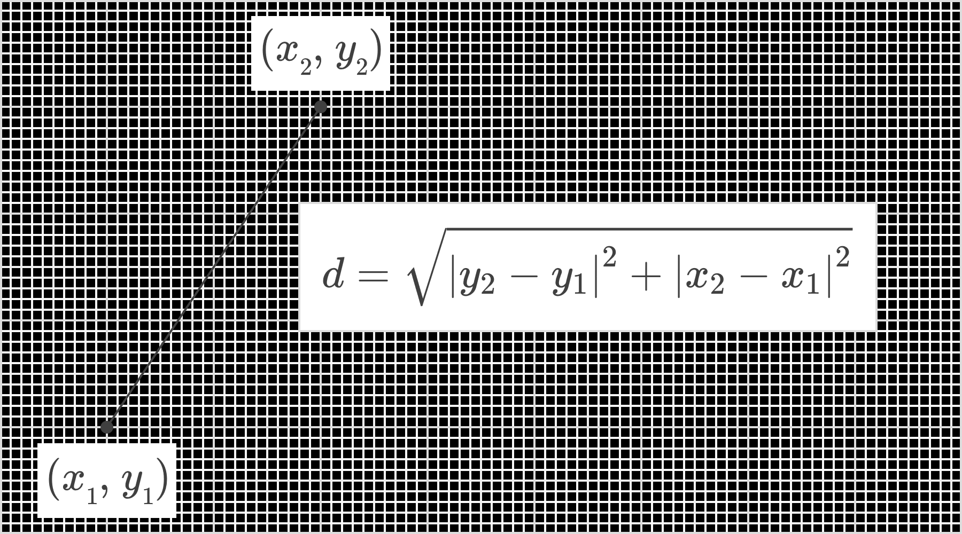
Calculation of Length:

Slide 6
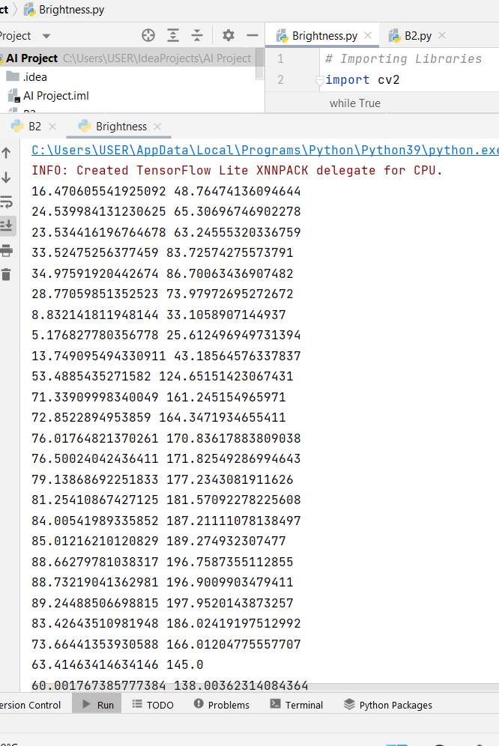
Outputs:

Slide 7
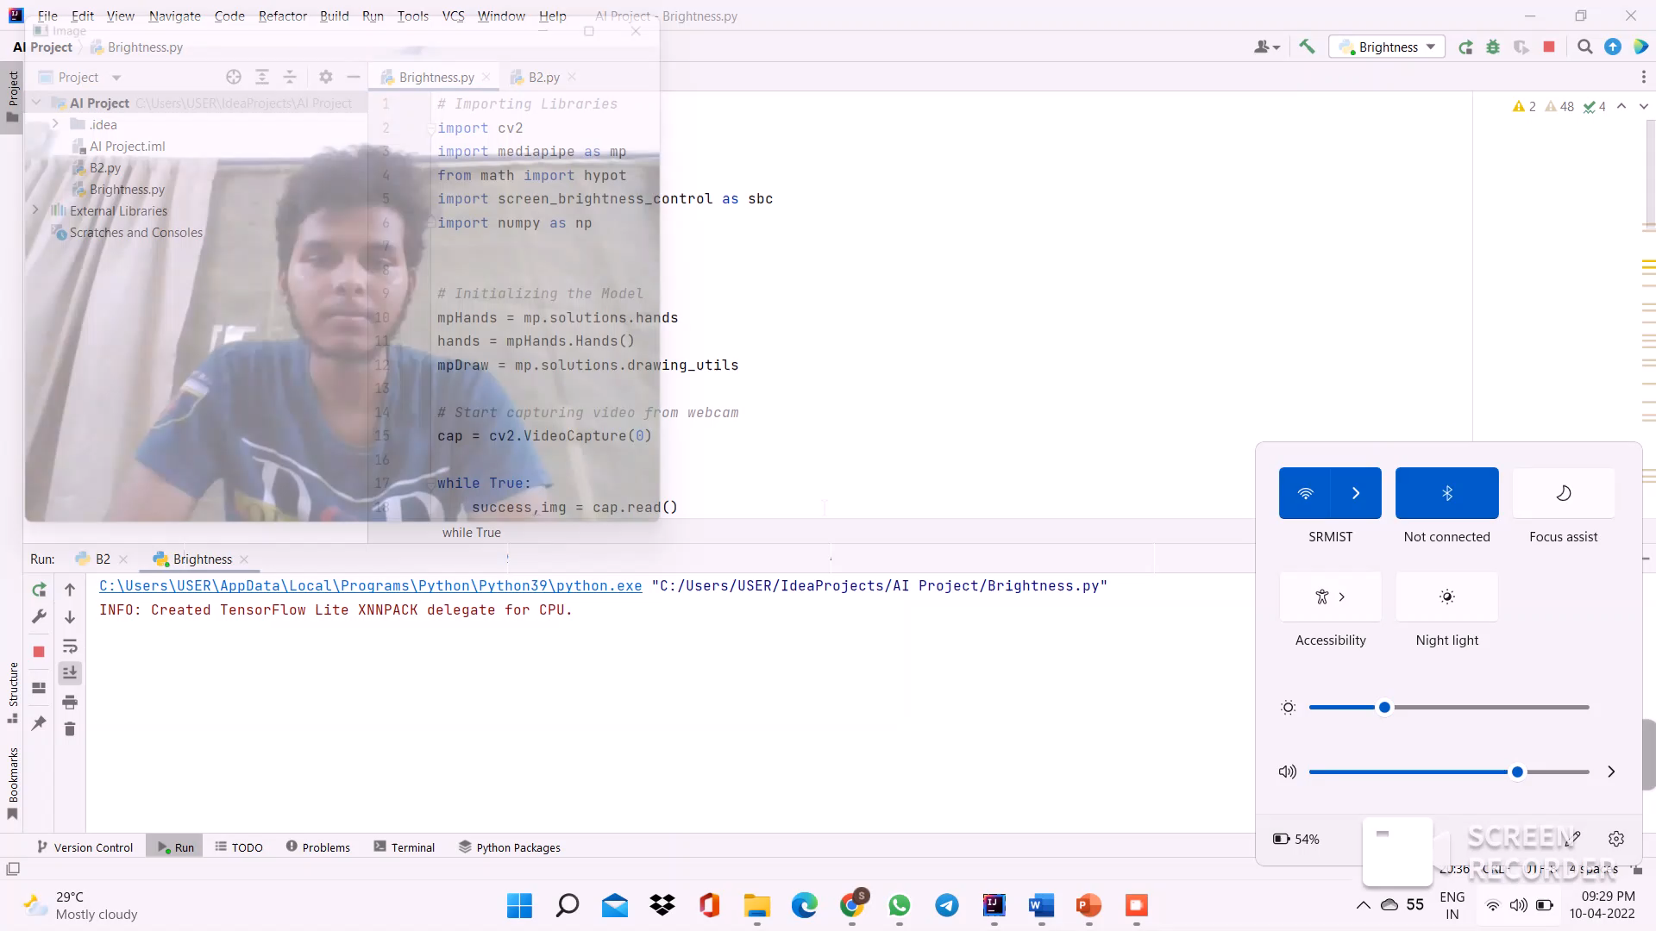
Sample video output:

Slide 8
Purpose of the problem statement (societal benefit)
Gesture recognition helps computers to understand human body language.
This helps to build a more potent link between humans and machines, rather than just the basic text user interfaces or graphical user interfaces (GUIs).
In this project for gesture recognition, the human body’s motions are read by a computer camera. The computer then makes use of this data as input to handle applications.

Slide 9
Result:
After successful completion of code in Intellij IDEA the brightness level of the system can be controlled with hand movements.

Slide 10
THANK YOU

